Slide 1
IMAGE TO PDF Convertor In JAVA
-By Rahul Jindal
04614802814

Slide 2
Reason to Choose Java
Simple
Object-Oriented
Platform independent
Secured
Robust
Architecture neutral
Portable
Dynamic
Interpreted
High Performance
Multithreaded
Distributed

Slide 3
Need Of The Application
Share files with others who use a different platform
Share files that will look the same (layout, fonts) on multiple computer systems
PDF documents have small size
Protecting the data from amendments by the third parties
It allows scalable text, vector images, and bitmaps to be combined in one document
No matter how much you want to enlarge your PDF file, the text it contains will look sharp and clear with the tiny details visible

Slide 4
Exploring the application

Slide 5
Resources
IntelliJ IDEA
Apache PDFbox
Java Jfilechooser

Slide 6
IntelliJ IDEA
IntelliJ IDEA is a Java integrated development environment (IDE) for developing computer software.
It is developed by JetBrains (formerly known as IntelliJ), and is available as an Apache 2 Licensed
It provide Coding assistance.
Built in tools and integration

Slide 7
Apache PDFbox
Apache PDFBox is published under the Apache License v2.0.
This project allows creation of new PDF documents
We can manipulate existing documents and extract content from documents by just few lines of code.
Eg- PDDocument document = new PDDocument(); PDPage blankPage = new PDPage(); document.addPage( blankPage ); document.save("BlankPage.pdf"); document.close();

Slide 8
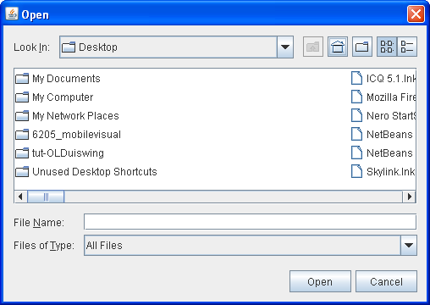
Java Jfilechooser
A Component of Java Swing library
Provides the GUI(Graphical User Interface) of open and save dialog box

Slide 9
Application functionality

Slide 10
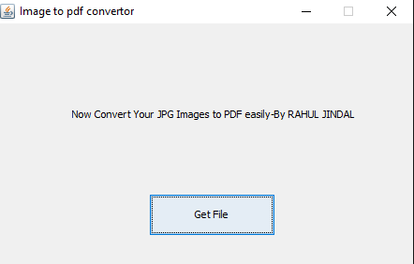
The Main Screen

Slide 11
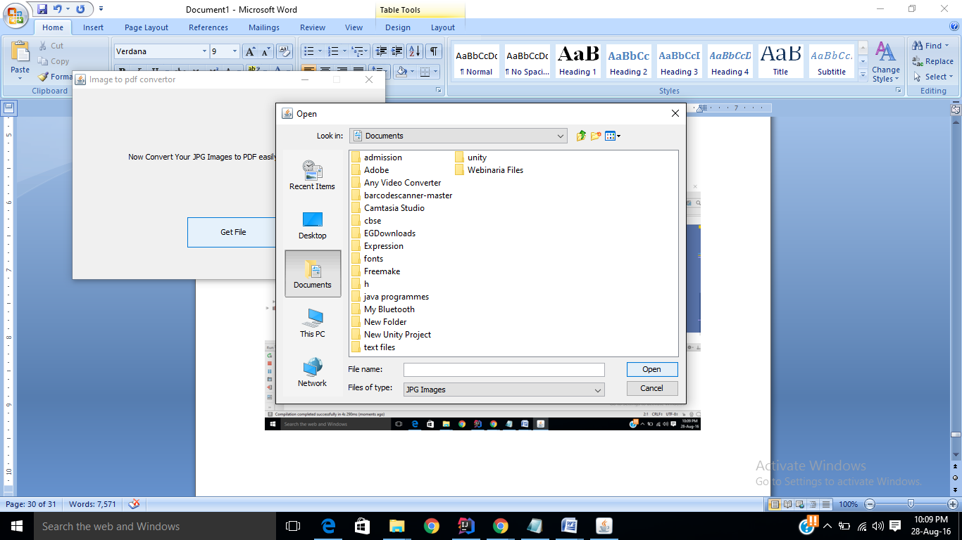
File Chooser Open Dialog

Slide 12
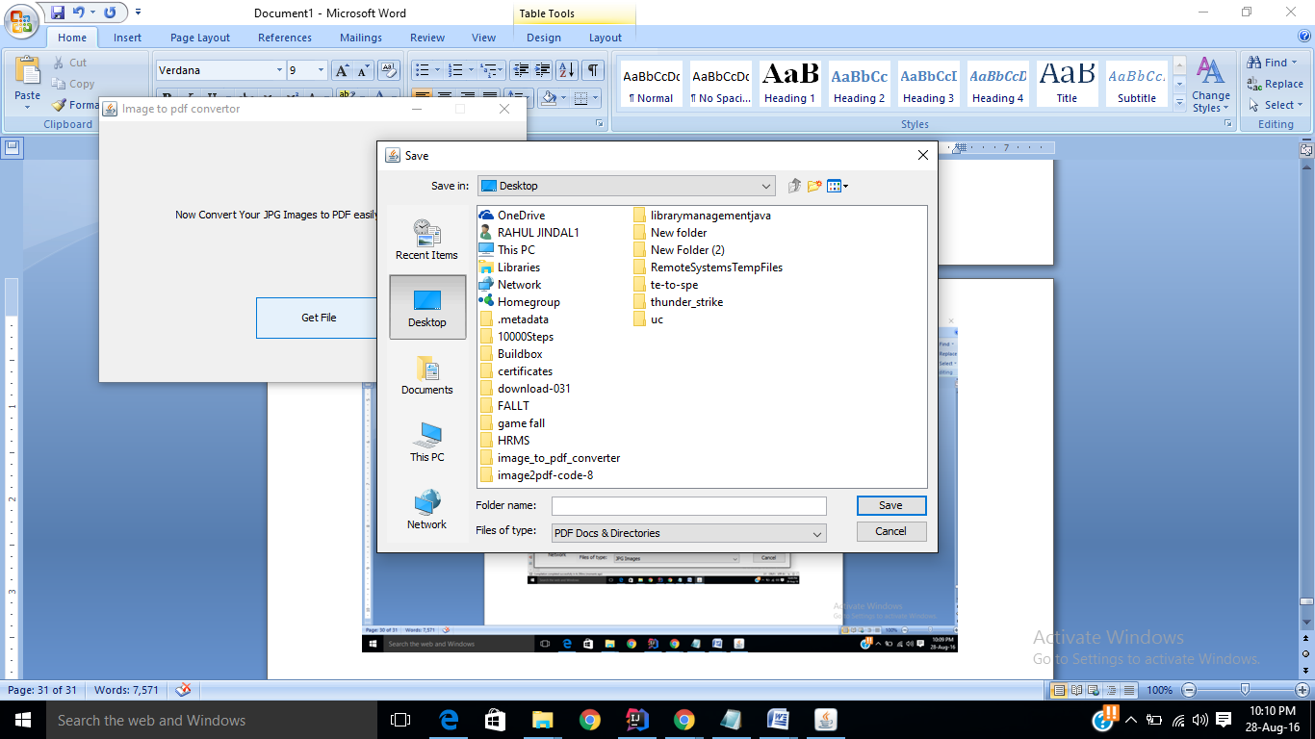
Save Destination Dialog

Slide 13
DEmo
Thank you

